Slide 1


Avinash Rai UNID : CRIN2301751
GOOGLE APP STORE Data analysis
Project Report by

Slide 2
Introduction
The project Google App Store Data Analysis defines various categories of apps.
Goal of this project is to provide insights about android applications categories and Rating of apps.
Various categories of apps are used in such as communication, Family, Finance, Gaming, Medical, Sports, News , etc .. To analyse the rating of the apps.

Slide 3
Architecture
Importing
Libraries
Missing Value Importation
Dataset
Read Dataset
Report
EDA
Data cleaning
Handling Outliers
Data visualization
By using EDA.
Documentation for
several graphs.

Slide 4
Data set
Contains various data on a set of apps in the google app store.
The data set is created due to the lack of public data set of google app store.
The dataset contains 33 categories of apps within it.

Slide 5
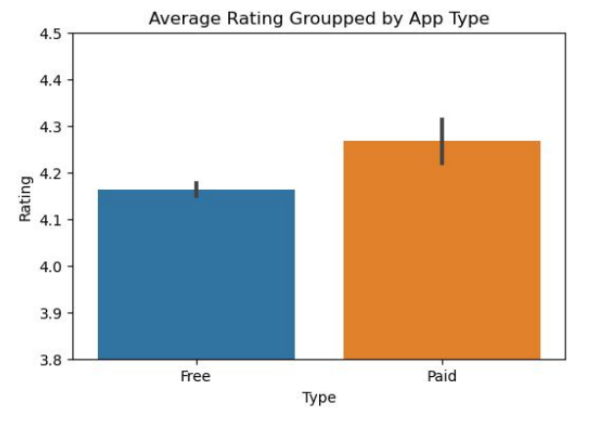
Insights from analysis
It shows the average rating between the free apps and paid apps.
The average rating of the paid apps is grater than free apps.

Slide 6
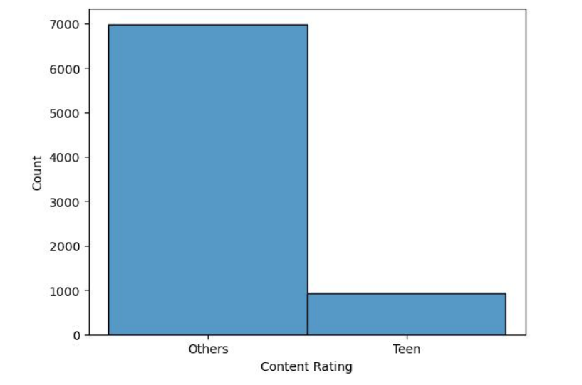
app Rating between teenagers and other people
The rating of teenagers is less than the rating of other people.
As show in the hist plot the rating of teenagers is 1000 and rating of the other people is near about to 7000.

Slide 7
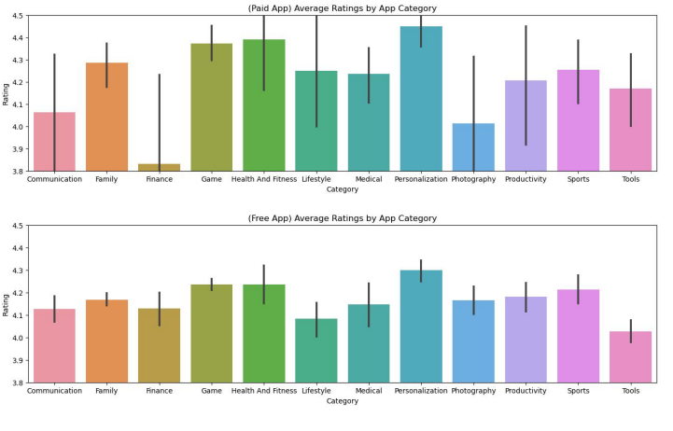
Different app categories
The plot shows the different categories of apps.
There are different categories between the paid apps and free apps.

Slide 8
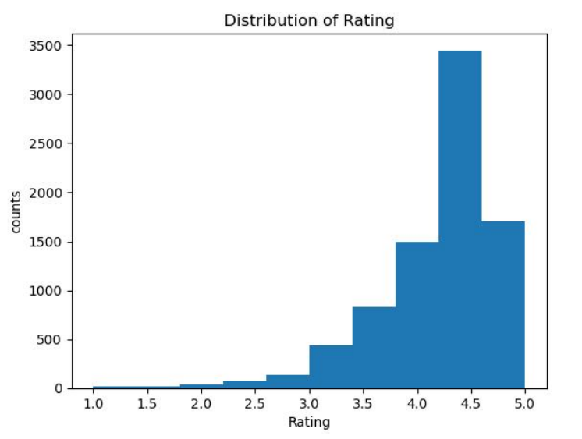
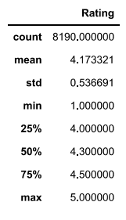
Rating of Data frame
Hist map shows the rating of the data frame.

Slide 9
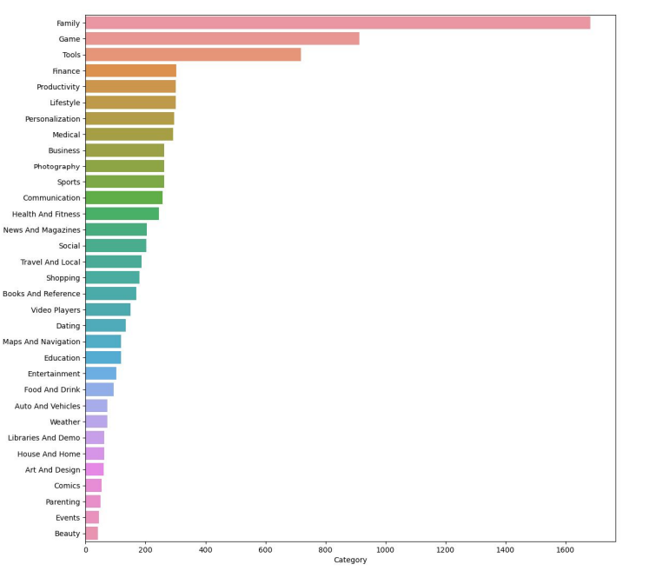
Famous Categories of apps
The plot shows the different categories of apps in the dataset.

Slide 10
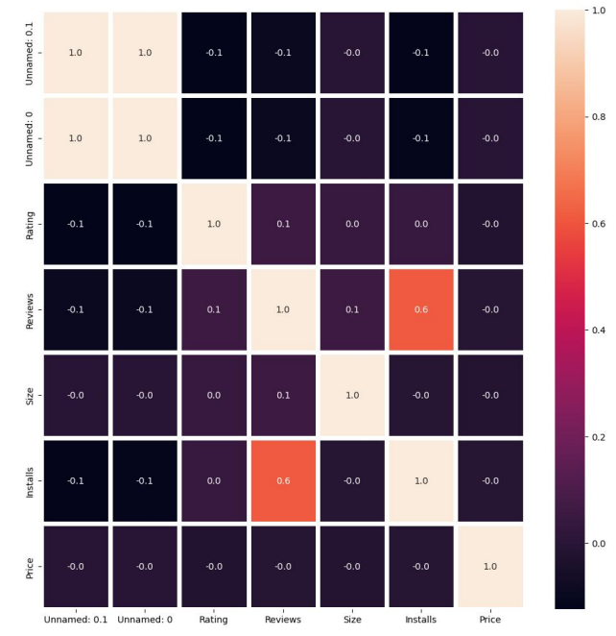
Heat map
The heat map shows the relationship between the various parameters in the dataset.

Slide 11

Thank You

